Slide 1
Enterprise OAuth 2.0 and OpenID Connect for Developers

Slide 2
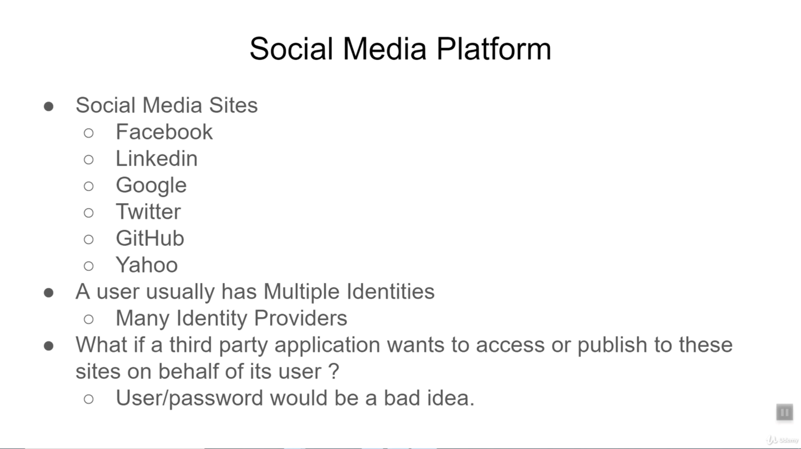

Slide 3
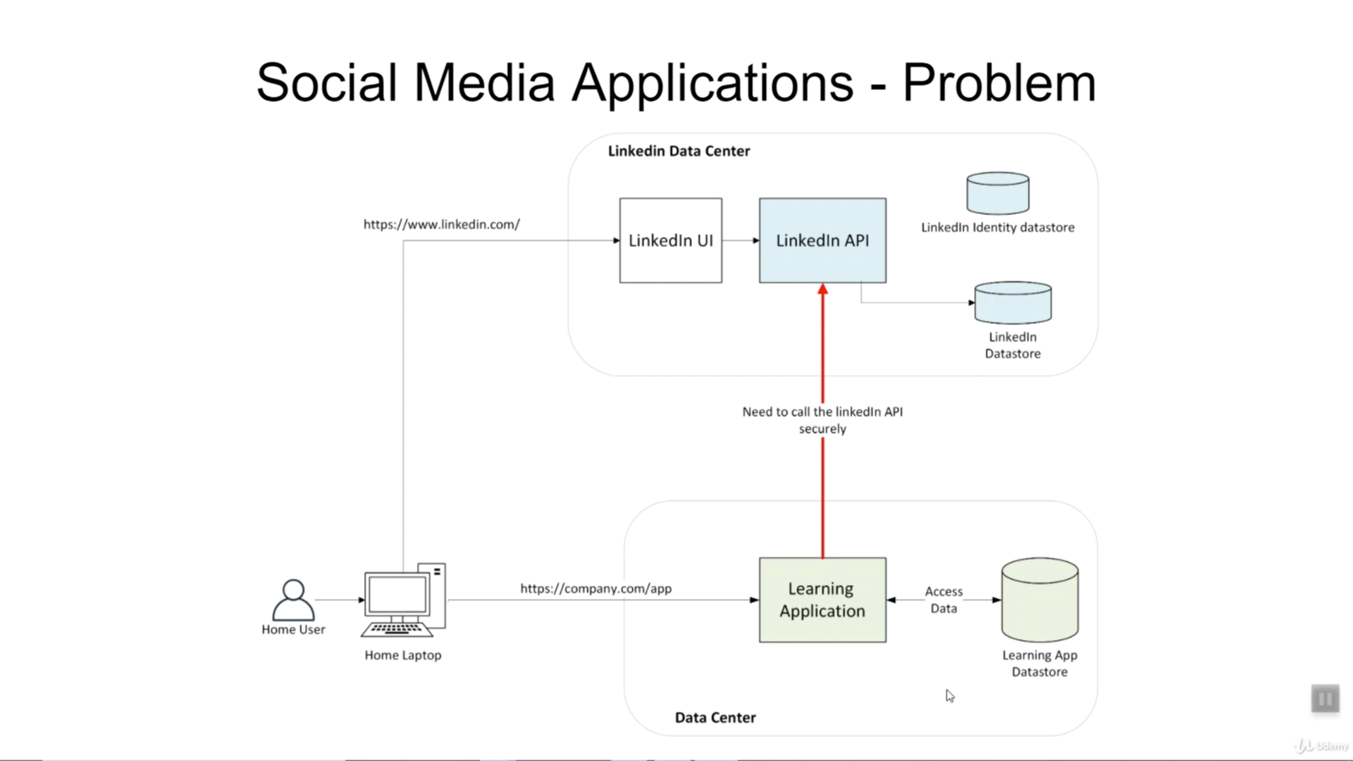

Slide 4
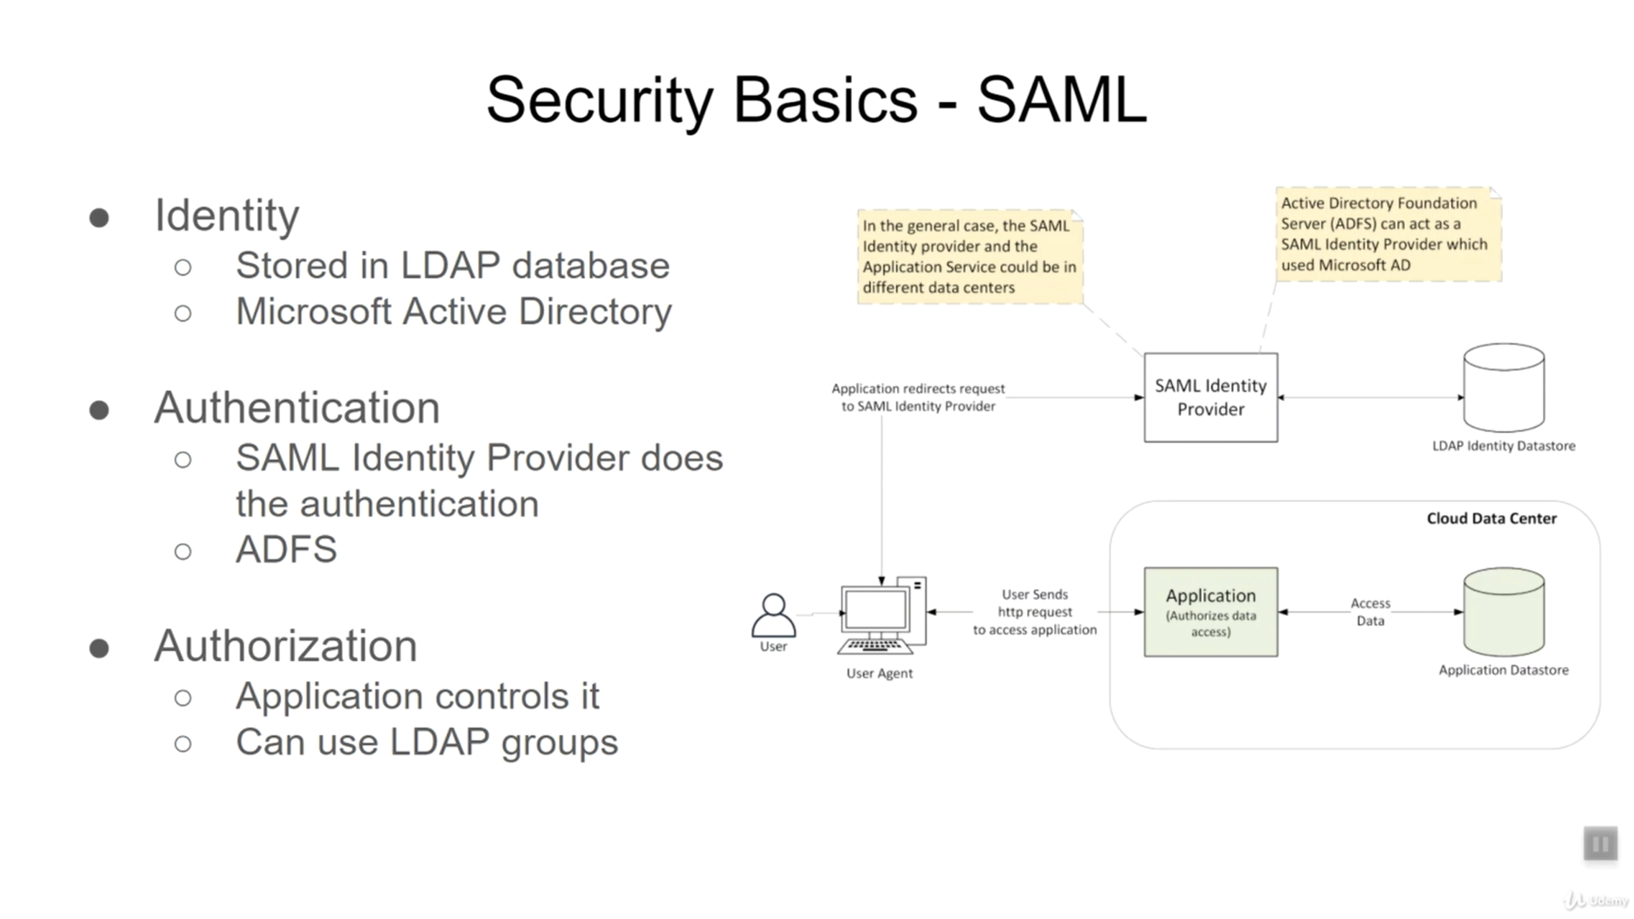

Slide 5
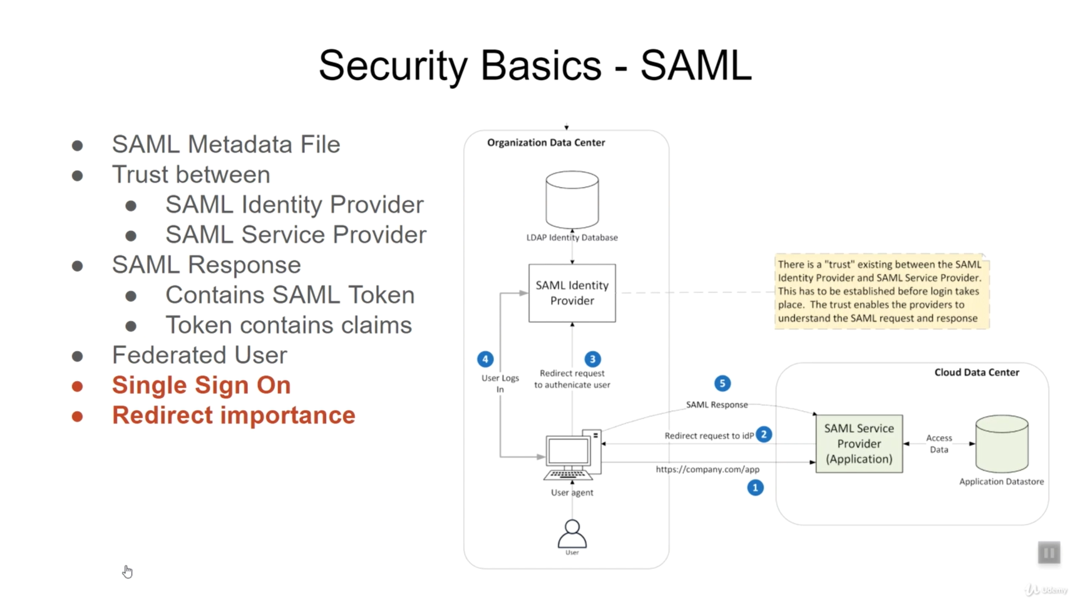

Slide 6
